Slide 1

The Fellowship of the Star Schema
Transforming OLTP Data for PBI
Kristyna Ferris
Please grab some swag!
Fun Fact: this font is dyslexic friendly! Ask me how to use it for free after the session.
Notes:
Top 10 Dyslexia-Friendly Fonts for 2026 | TypeSmith | TypeSmith
Download the font from Atkinson Hyperlegible - Google Fonts
Extract the files
Go to computer settings > personalization > fonts and drop in the files
Navigate to Power Point Master Slide
Change the font to use Open Dyslexic for the headers and body
Done!
Atkinson Hyperlegible uses exaggerated asymmetry between mirrored letter pairs (b/d, p/q) and uniquely shaped terminals that prevent letter confusion.
Its design by the Braille Institute incorporates research on visual processing differences to minimize misrecognition at any size.

Slide 2

About Me ~ Kristyna Ferris
Microsoft MVP, Data Platform & Fabric
Solution Architect, P3 Adaptive
Lexington Data Tech Group co-organizer
DataOnWheels Author
Blog
https://dataonwheels.wordpress.com/
LinkedIn
https://www.linkedin.com/in/kristyna-ferris-dataonwheels/
Twitter & Bluesky
@data_dragoness

Slide 3

A Quiet Start in the Shire: Life in OLTP
"In a hole in the ground there lived a hobbit and a very efficient transaction system.“
Built for doing, not analyzing.
Every table has one job.
Dozens of normalized tables, optimized for speed.
Powers the front line like order entry, banking, point of sale, etc.
Writes fast, reads hard making it terrible for reports.

Slide 4
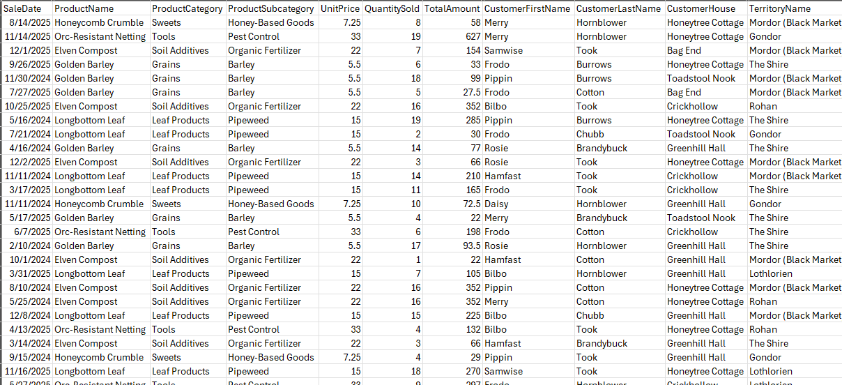
Sample OLTP Sales Table

Slide 5
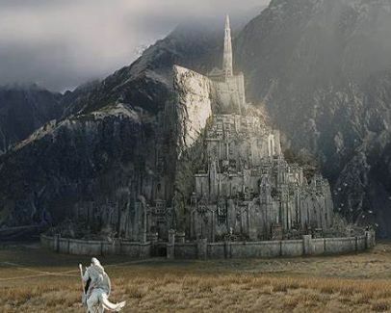
Arriving in Gondor: OLAP Citadel of Insight
"The beacons are lit! The analysts call for data!“
Built for analyzing, not doing.
Fewer, wider, organized tables.
Designed for query speed across millions of rows
Serves analysts, executives, and Power BI.
Data refreshed hourly or daily and prioritizing accuracy over immediacy.
Use cases: forecasting, sales analysis, executive reporting

Slide 6
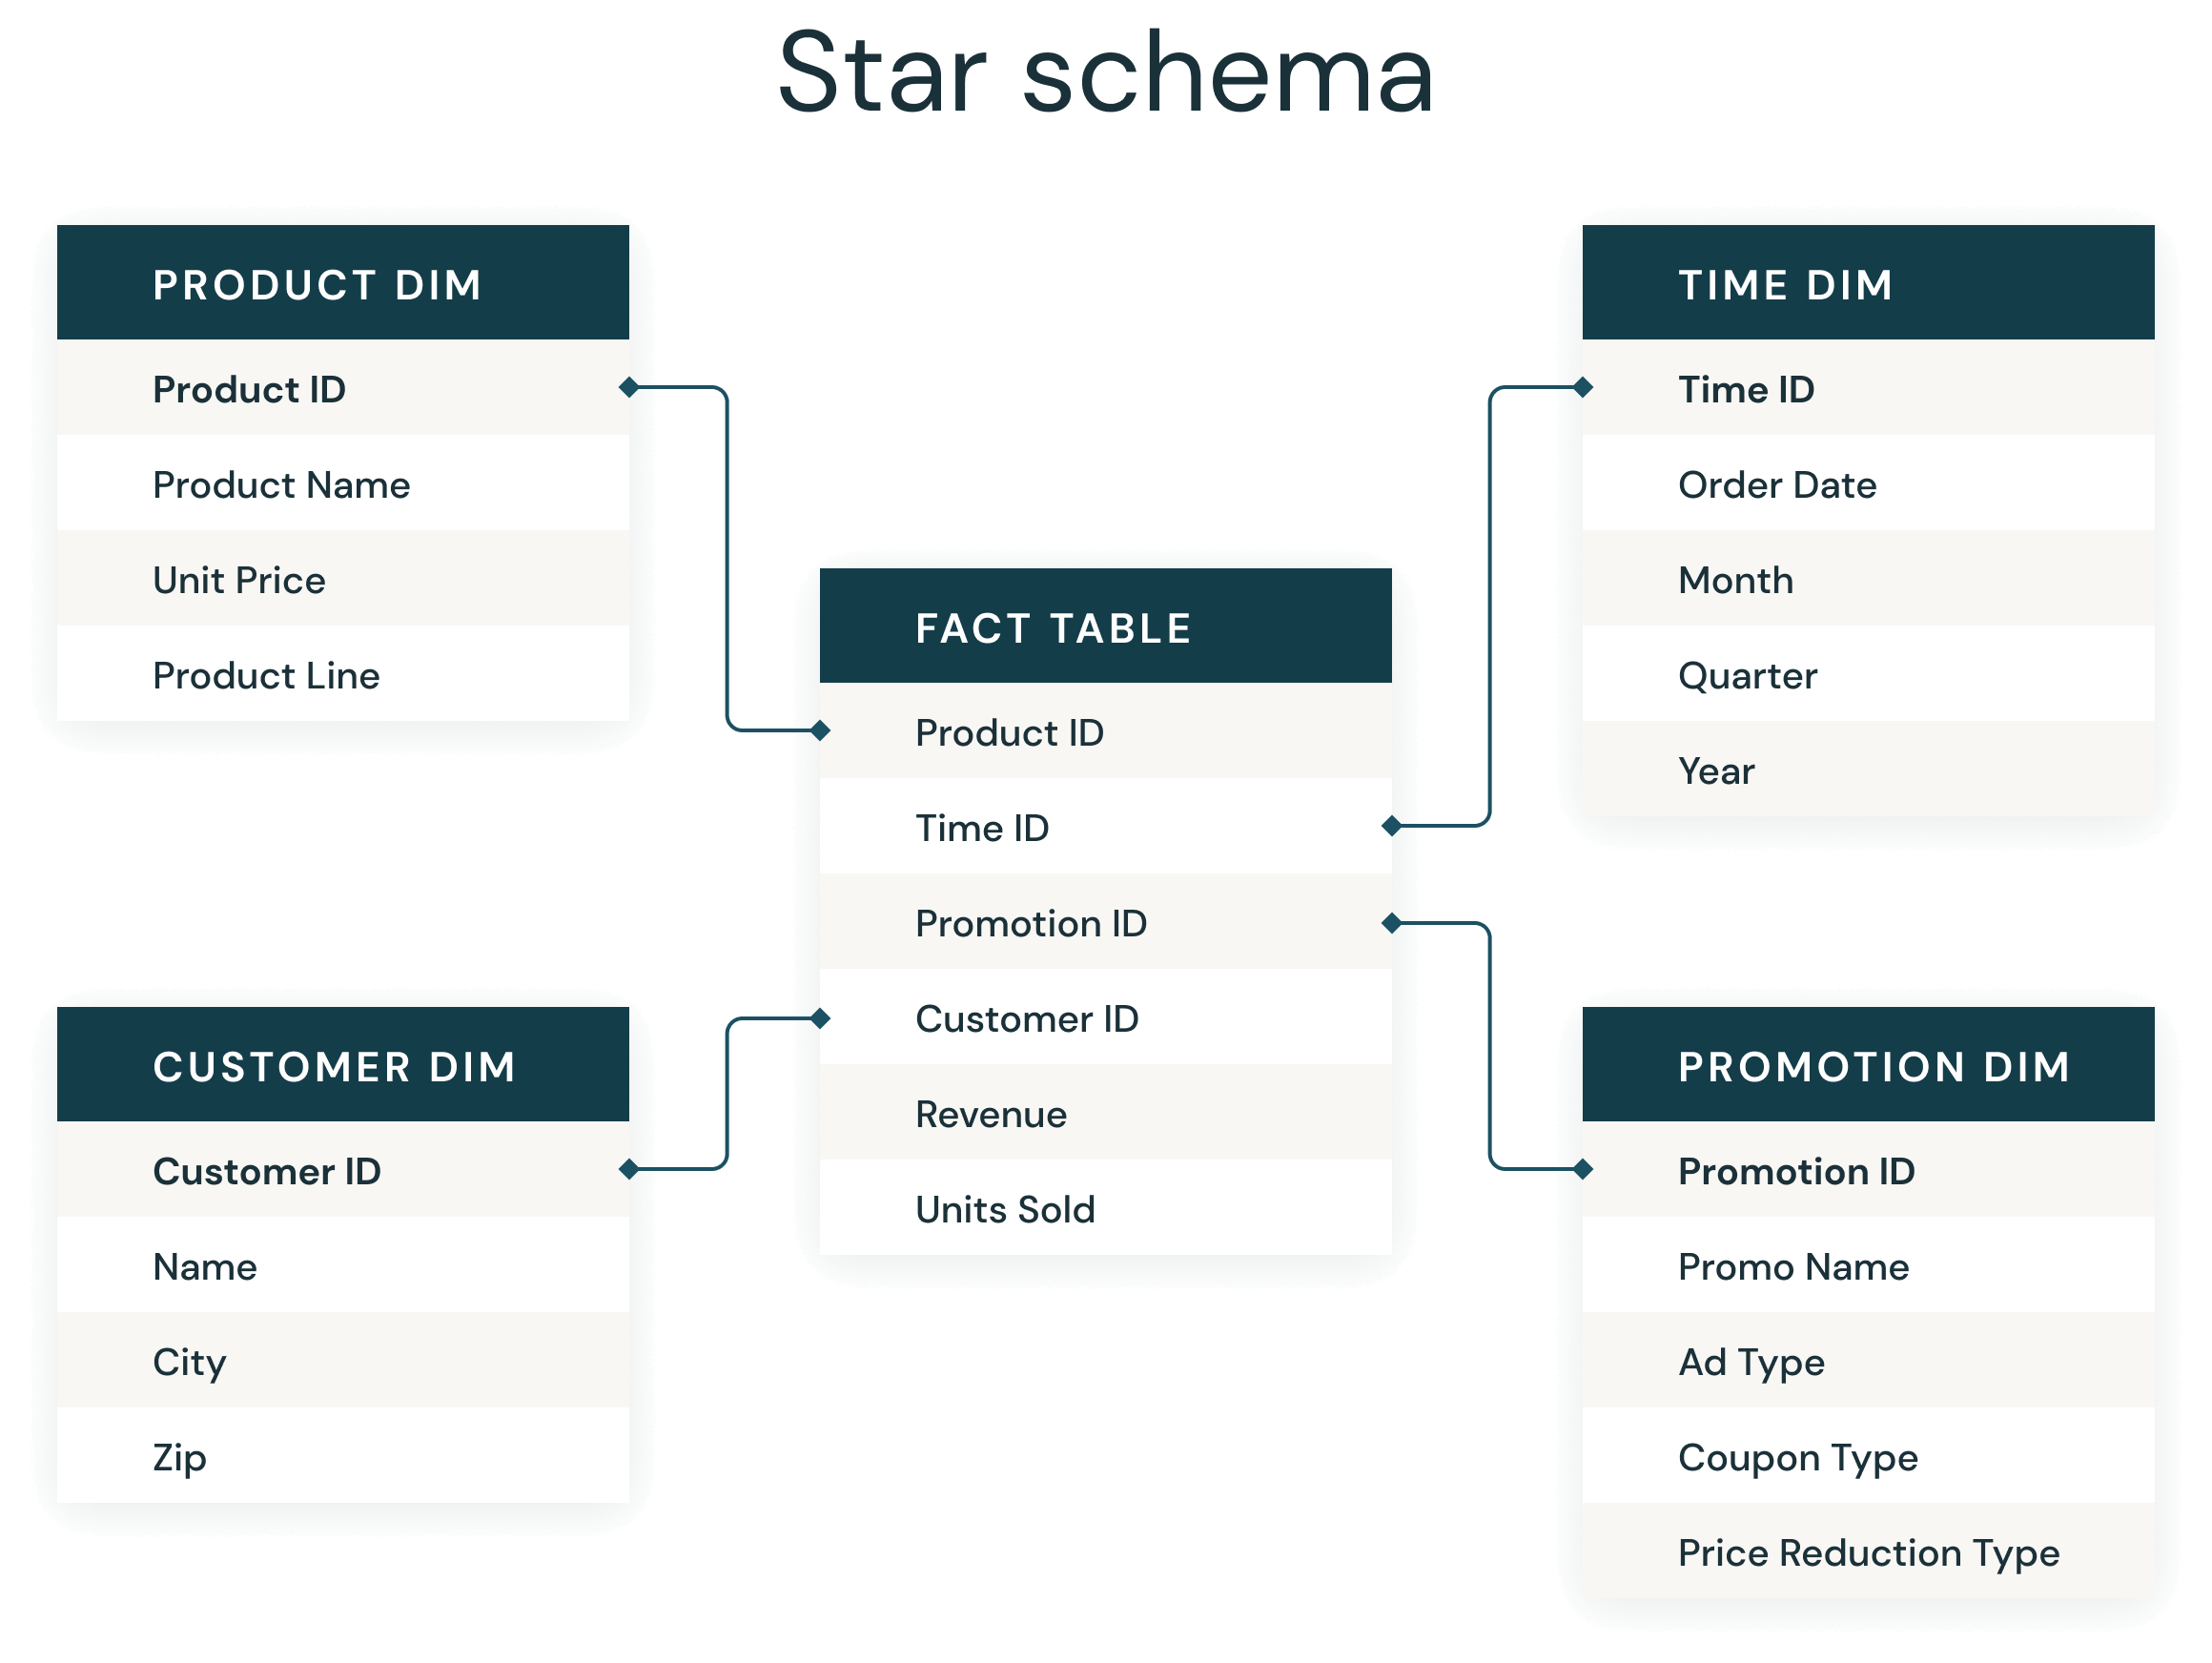
Sample OLAP Star Schema

Slide 7
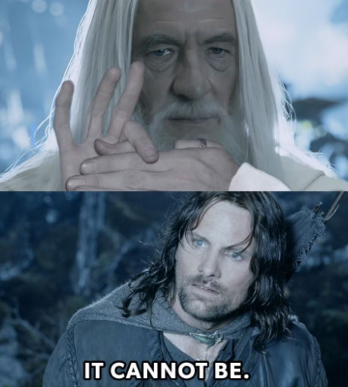
Demo Time!

Slide 8
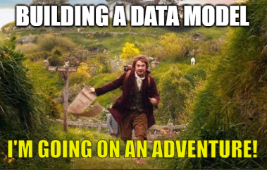
Journey to OLAP: Following the Star Schema
"One fact table to rule them all, and in the darkness, dimensions bind them.“
A proven design pattern for analytics.
Central fact table holds the numbers: sales, revenue, inventory.
Surrounding dimension tables give context: who, what, when, where.
Purpose-built for Power BI's Vertipaq engine with fewer tables, faster queries.
Unlocks slicers, hierarchies, and time intelligence out of the box.

Slide 9

The Council of Stakeholders: Defining the Quest
"You cannot pass... until you've answered these questions.“
Before a single table is touched, the council must convene.
Notes:
Pull out the bus matrix!

Slide 10
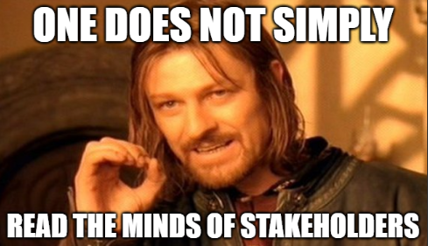
The Council of Stakeholders: Defining the Quest
What decisions will this data drive?
What are the "make more money" metrics that matter most?
What grain and scope does the data need?
Who uses this report -- and how do they slice it?
What dimensions give context to the metrics?
Where does the data live today?
Are there data quality landmines waiting to explode?
How often do these questions need answering?
Notes:
Pull out the bus matrix!

Slide 11
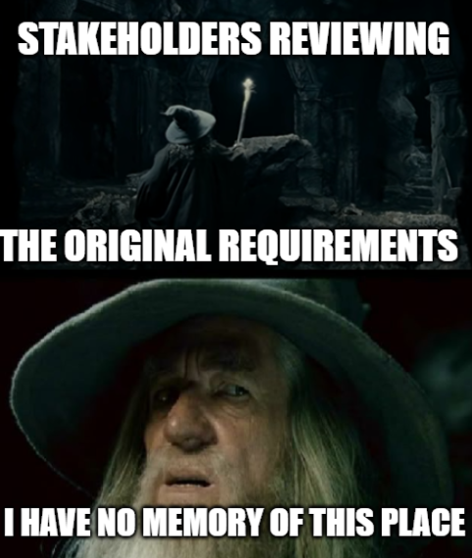
Pro Tip: Hold the Council Accountable
"A wizard is never late, but a stakeholder will absolutely forget what they asked for.“
Write the answers down and email them to stakeholders.
Creates a paper trail when scope creep shows up uninvited.
Even better: put the answers on a hidden page in the report itself.
The purpose of the report travels with the report.
Notes:
Pull out the bus matrix!

Slide 12
Mapping the Star Schema: Bus Matrix
Focus on measurable, event-based processes.
May result in the need for multiple reports and highlight missing data.
Dimensions → Business Process / Facts ↓ | Date | Product | Customer | Territory | Store
Sales
Inventory
Returns
Notes:
Benefits:
Clarifies Scope: Stakeholders see what data is needed and where it overlaps.
Encourages Reuse: Promotes conformed dimensions—single definitions reused across processes.
Supports Iteration: You can build out your data warehouse in increments.
Bridges Tech & Business: Translates messy system tables into understandable business concepts.
Facilitates Power BI Modeling: Leads to semantic models that support consistent slicing/filtering.
Don’t be afraid to include data that doesn’t exist for now.

Slide 13

Guidance from the White Council: Best Practices 1
"Even the smallest column can change the course of the future.“
Create an integer key for dimensions. If one doesn't exist, make one
Each column lives in exactly one place. Customer Name belongs in the Customer dimension.
Names must be specific. "Name" in both Product and Customer dimensions helps no one, call it what it is.
Notes:
Part 1

Slide 14
Guidance from the White Council: Best Practices 2
"Speak, friend, and enter. Name your columns like a friend would.“
Use friendly column names. Spaces are fine in Power BI. "Customer Name" beats "cust_nm" every time.
Don't import what you don't need. Every unused column is dead weight on the journey.
One row per thing. Each dimension row represents exactly one customer, product, date. No doubles.
Notes:
Part 2

Slide 15
Guidance from the White Council: Best Practices 3
"All we have to decide is what to do with the columns we are given.“
Relationships run one way: dimension to fact. One-to-many, every time. Fact-to-fact relationships are the dark path through Mirkwood forest of poor performance. Do not go there.
Roche's Maxim: transform as far upstream as possible, as far downstream as necessary.
Do the heavy lifting in SQL or your ETL. DAX is for reporting logic, not data shaping.
Notes:
Part 2

Slide 16
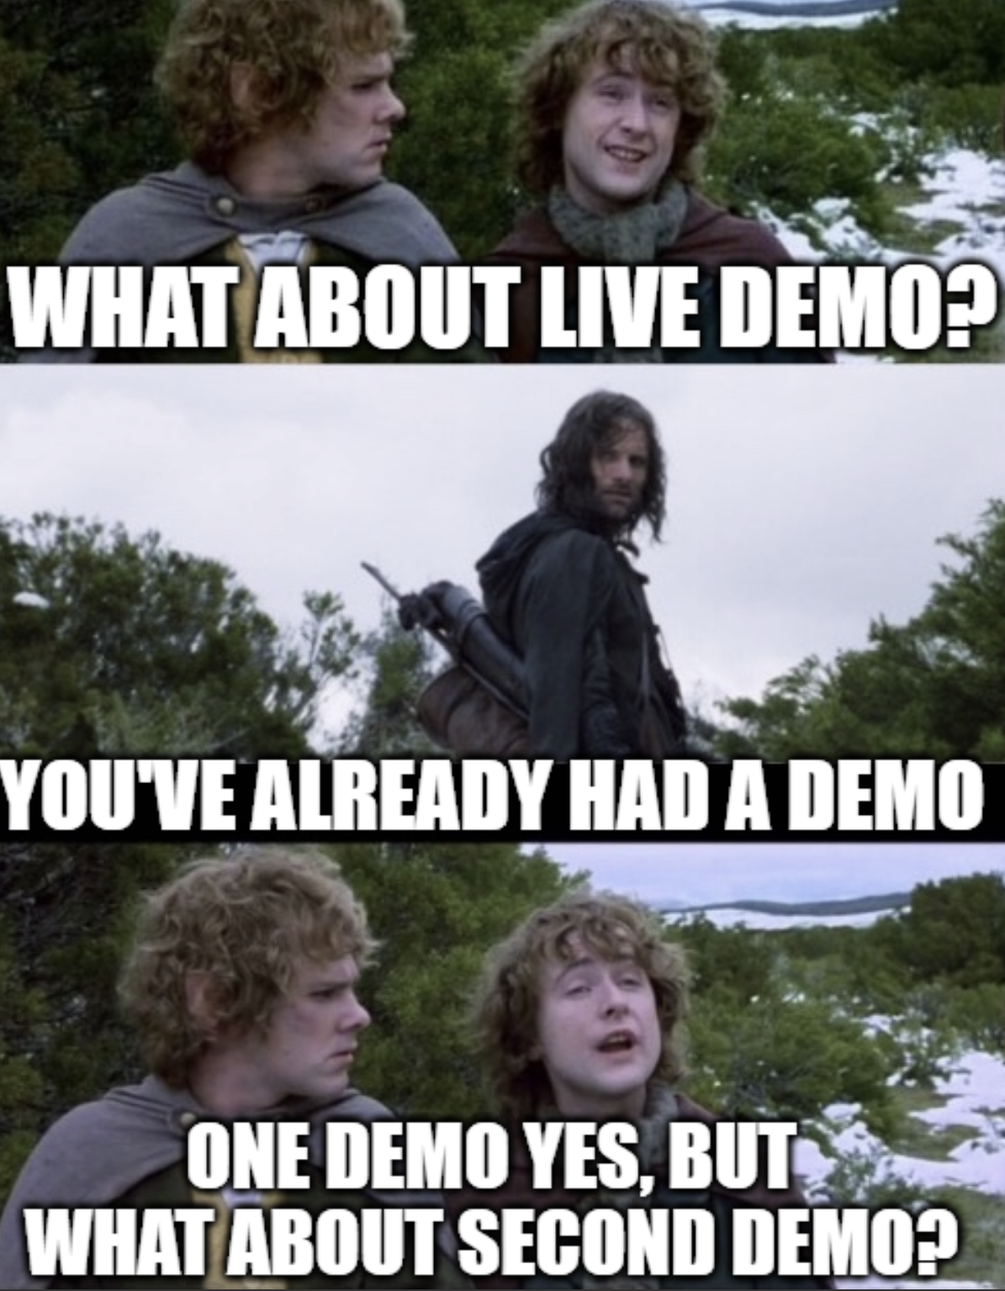
Demo Time!

Slide 17

Light the Beacons!
Trusted Allies
Guy in a Cube
Kimball Group
Story BI training (hands-on course)
Pragmatic Works
Local user groups
Stalk the speaker list at conferences, they usually have other resources.
Additional Topics to Explore
Slowly changing dimension type 2
Measures versus columns
Vertipaq engine optimization
Cardinality
Creating a date table
Notes:
Article & Design Tips at Kimball Group https://www.kimballgroup.com/category/articles-design-tips/ for free articles covering 20 years.
Dimensional Modeling in Fabric Warehouse (Microsoft Learn) https://learn.microsoft.com/en-us/fabric/data-warehouse/dimensional-modeling-overview
Why Power BI Loves a Star Schema: https://www.youtube.com/watch?v=vZndrBBPiQc
https://learn.microsoft.com/en-us/power-bi/guidance/star-schema

Slide 18

Don’t forget to connect, thanks for listening!
https://dataonwheels.wordpress.com/
kristyna@dataonwheels.com
@data_dragoness
GitHub

